Slide 1
Nitrogenous Bases

Slide 2
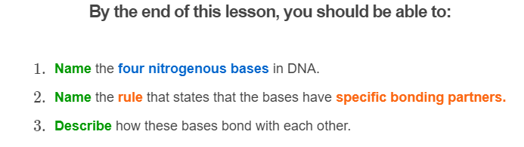

Slide 3
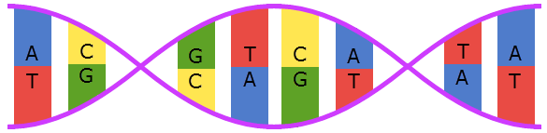
So far, we have treated all nitrogenous bases as being the same.
In reality, there are four types of bases, each represented by a capital letter:
adenine (A)
thymine (T)
guanine (G)
cytosine (C)

Slide 4
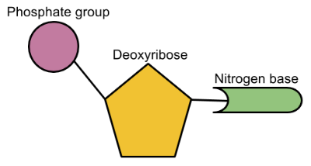
Because there are four types of nitrogenous bases, there are also four types of nucleotides.
Remember, nucleotides are made up of a deoxyribose sugar, a phosphate and a nitrogenous base.

Slide 5
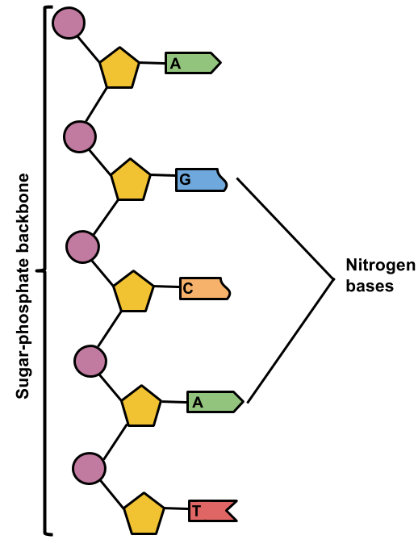
The sugar and phosphate are always the same, so nucleotides only differ in the type of base they contain.
As a result, the nucleotides are named after their nitrogenous bases. For instance, a nucleotide with a thymine base is a thymine nucleotide.
This is an important piece of terminology, as geneticists often refer to nucleotides rather than nitrogenous bases.

Slide 6
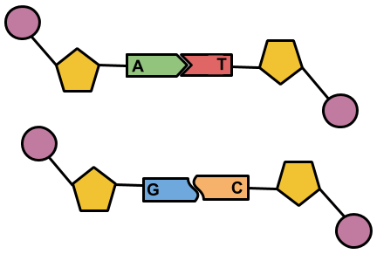
When making base pairs, the bases always bind to specific partners.
Adenine (A) and thymine (T) bind: A-T
Cytosine (C) and guanine (G) bind: C-G
A good way to remember the base pairing rule is that the letters C and G are curvy and go together and A and T are straight and go together.

Slide 7
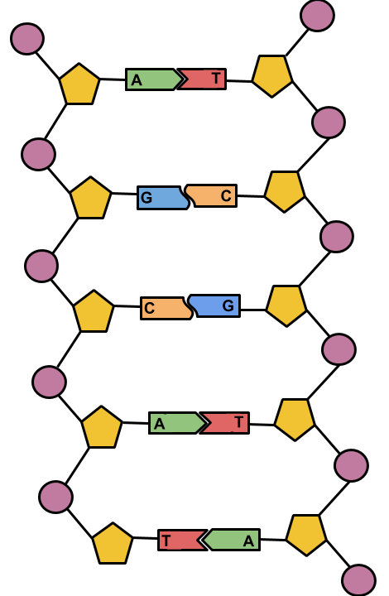
Therefore, the only possible base pairs are:
A-T and C-G
Other pairs, such as A-G, cannot exist.

Slide 8


This is called the complementary base pair rule.
The nitrogenous bases are also referred to as being complementary.

Slide 9


Nitrogenous bases have specific binding partners because the four types of nitrogenous bases have different shapes.
Like a lock and key, the wrong shapes will not fit together, preventing base pairs like A-C or T-G.

